Slide 1
Artificial Intelligence Mini Project
Team Members
P.S.A.BHASKAR REDDY - [072]
V.R.S.MURTHY REDDY - [075]

Slide 2
Topic : Gmail Spam Detection
Gmail is the worldwide use of communication application. It is because of the ease of use and faster than other communication application. However, its inability to detect whether the mail content is either spam or ham degrade its performance. Nowadays, lot of cases have been reported regarding stealing of personal information or phishing activities via gmail from the user. This project will discuss how machine learning help in spam detection. Machine learning is an artificial intelligence application that provides the ability to automatically learn and improve data without being explicitly programmed. The algorithm will predict the score more accurately. The objective of developing this model is to detect and score word faster and accurately.

Slide 3
Objective :
The objective of this project is to build a prediction model to predict whether a mail is spam or not.

Slide 4
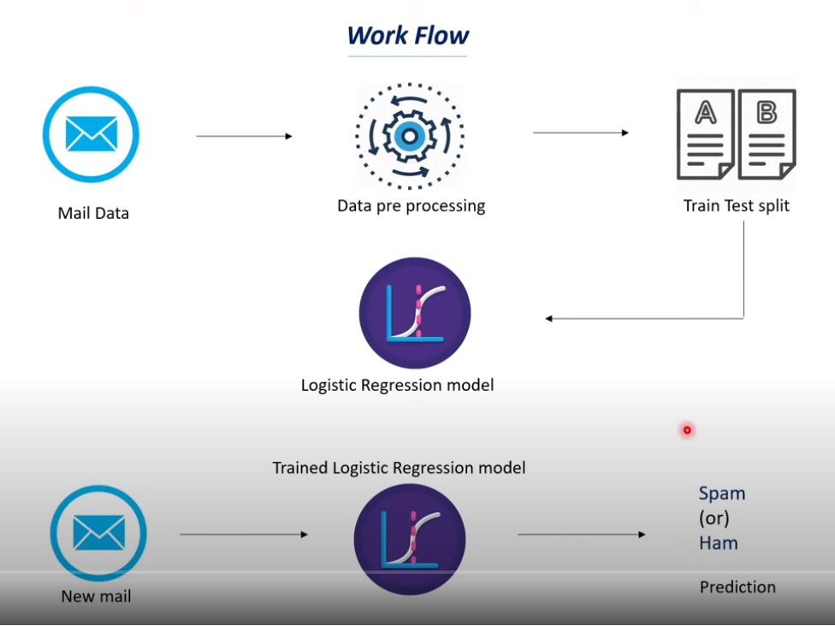

Slide 5
STEPS INVOLVED:
Label Encoding
1.Importing Dataset
2.Preprocessing Dataset
3.Label Encoding
4.Splitting the data into training data & test data
5.Logistic regression
6.Evaluating the trained model

Slide 6
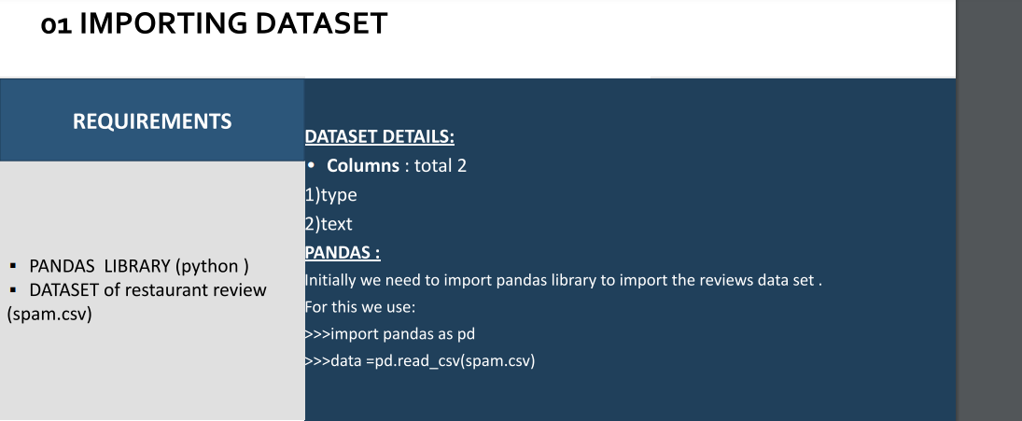
1.Importing Dataset

Slide 7
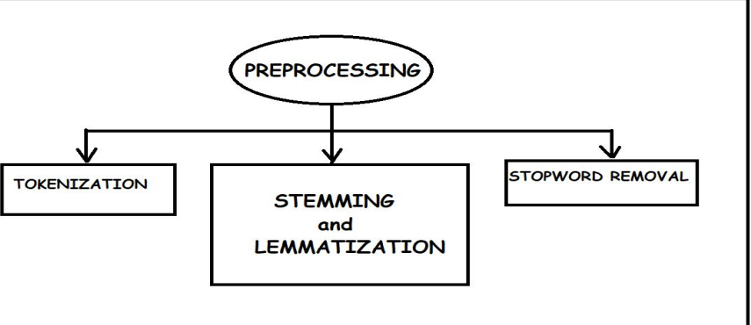
2.Preprocessing Dataset

Slide 8
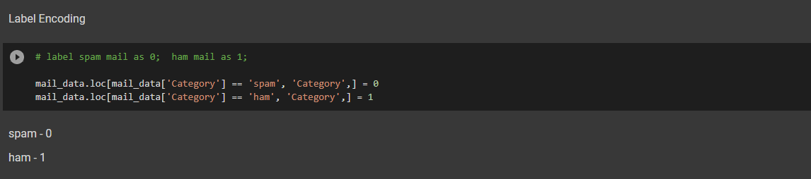
3.Label Encoding

Slide 9
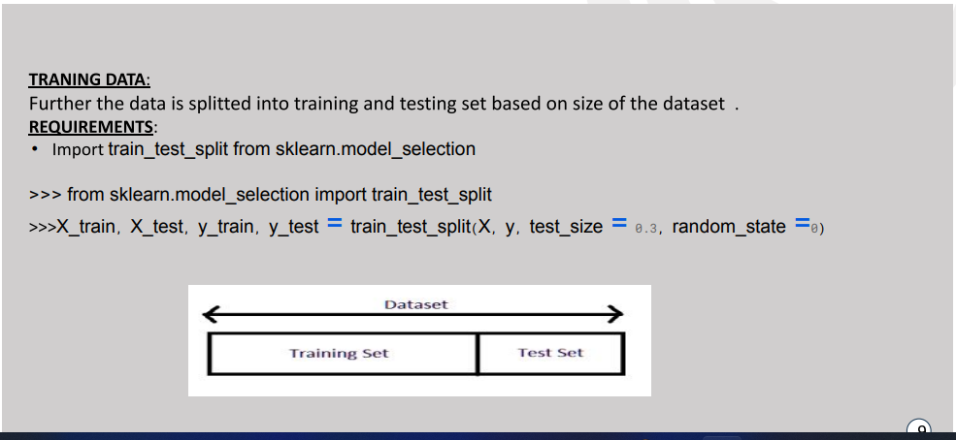
4.Splitting the data into training data & test data

Slide 10
5.Logistic Regression :
Logistic regression is a process of modeling the probability of a discrete outcome given an input variable. The most common logistic regression models a binary outcome; something that can take two values such as true/false, yes/no, and so on.

Slide 11
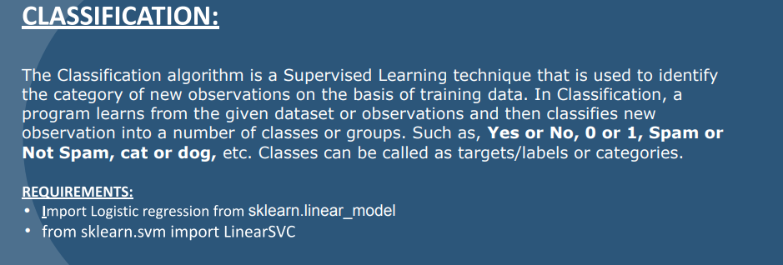

Slide 12
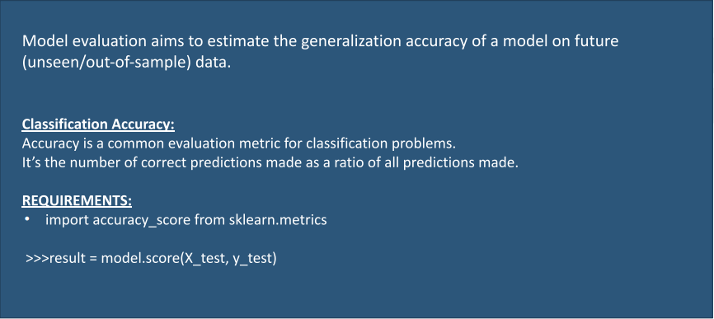
6.Evaluating the trained model

Slide 13


